Slide 1
NOTICE BOARD
SYSTEM
St. By :- Satyajeet Chourasia

Slide 2
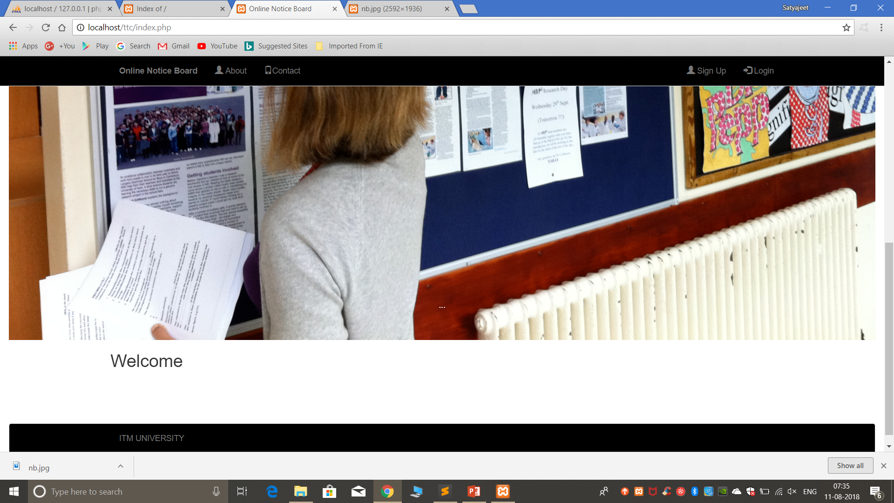
WELCOME

